Slide 1
Group 20
Level 5 – Max Carter
Level 5 – Ross Warren
Level 4 – Jake Seaman
Level 4 – Jack Fuller
Notes:
Introduce group members in order shown

Slide 2
Brief Summary
Constraints
2D Environment
Physics based mechanic
Adversarial
Played on a single device
Symmetric
Simple rules
MC

Slide 3
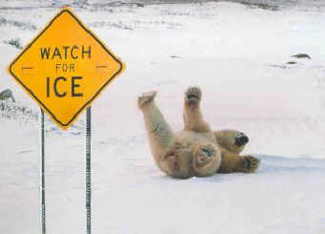

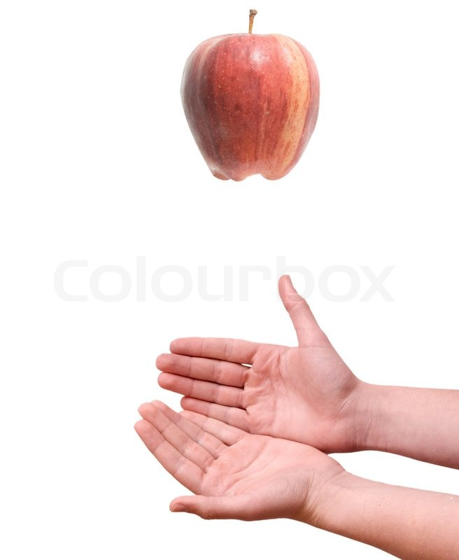
Game Ideas
Friction
Buoyancy
Gravity
JS

Slide 4
Mechanics - Friction
Timing mechanic
Both players have a key press
Upon key press, that player’s character momentum will stop.
JF

Slide 5
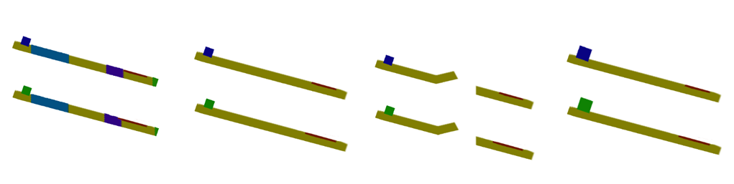
Iterations
The increasing and decreasing of friction.
The movement of the end goal.
Player character also effecting the friction.
Instant stop or slow stop
Large and friction affecting player character.
Different level frictions.
Jumps.
Moving end goal.
RW

Slide 6
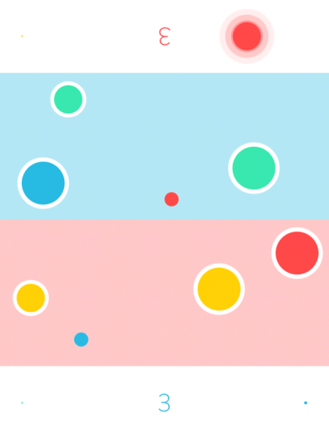
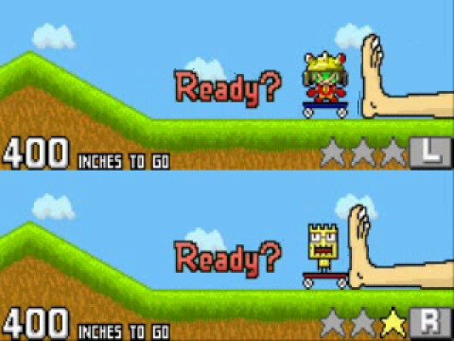
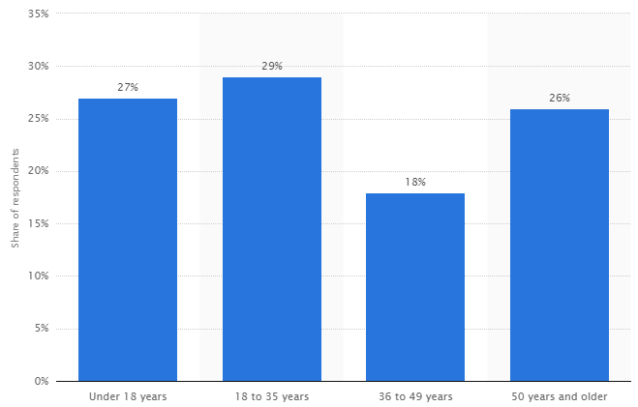
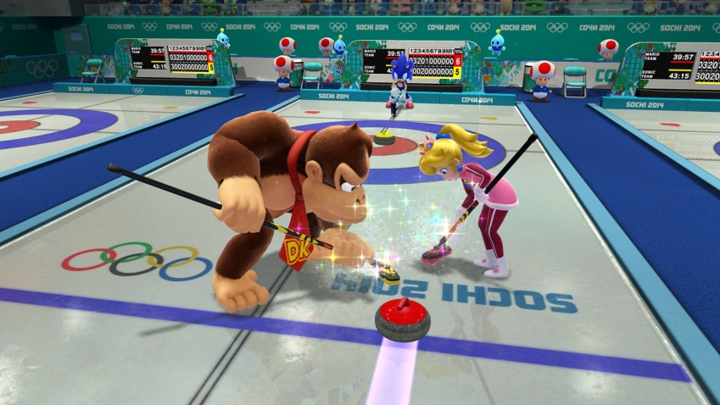
Research + Demographic
Established demographic of mostly males aged 12 – 35
Colourful
Vibrant
Minimalist or smooth
https://www.statista.com/statistics/189582/age-of-us-video-game-players-since-2010/
RW

Slide 7
Intended Player Experience
Fiero
People Fun
Competitiveness

Slide 8
Design Ideas and Themes
Best egg chef
Stunt snails
Toilet cleaning
Dolphin oil spill
Headlice removal

Slide 9
Prototype

Slide 10

Playtesting results
Smiling
Celebration
Schadenfreude
Light annoyance at opponent (when very close)

Slide 11
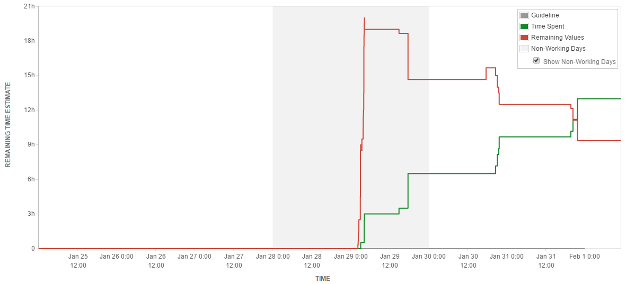
JIRA Burndown Chart

Slide 12
Questions?
Notes:
Thank ou for your time we will now awnser any questions you have.

